Slide 1
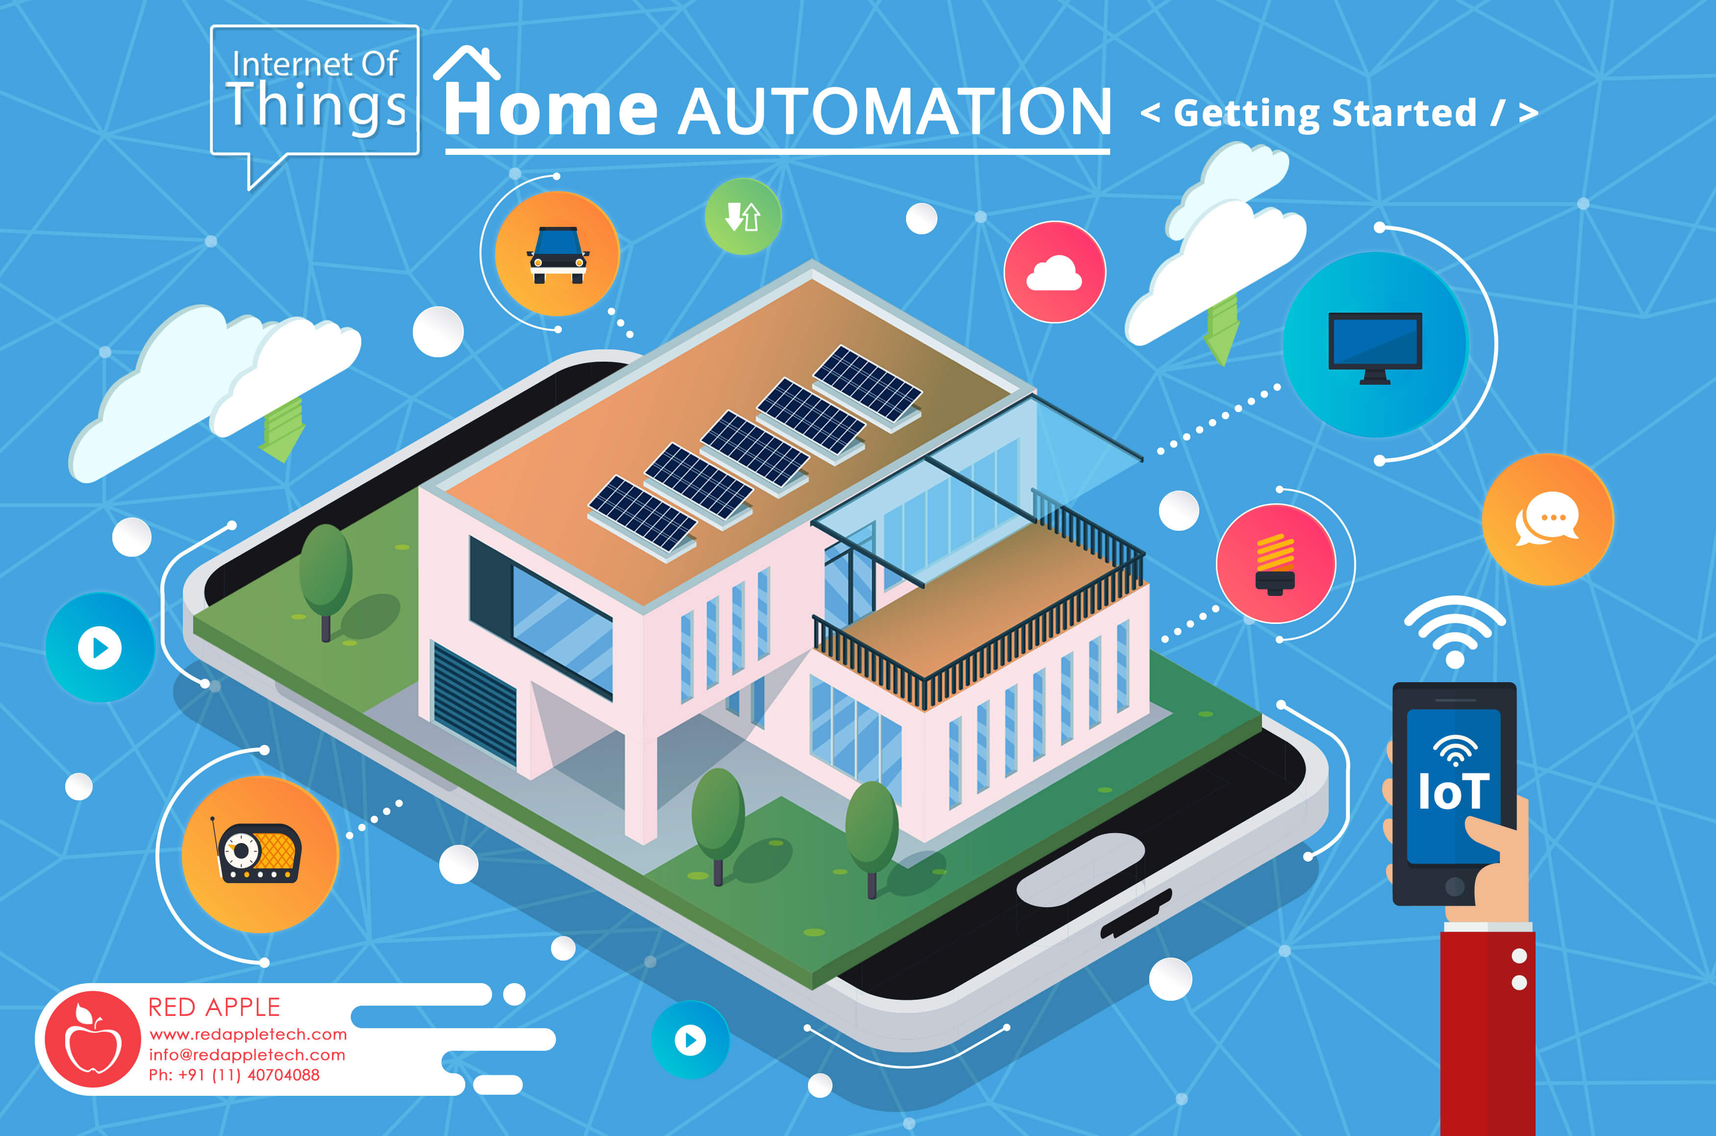

Slide 2
ABSTRACT
Now-a-days with the advancement in the technologies, IOT is boosting up continuously by deploying and innovating various smart devices which helps to modernize the society. This project Smart Home Automation using Alexa is already implemented with quiet expensive devices and used by many people but not everyone can afford that model to convert their home into smart home. Through this project the people who dreamt of living in a smart home with less cost and want to get hands on experience of automated device technologies will come true. In this the user will learn and use the recent trending technologies which is machine learning and also provide the information about and how to manage their usages and stay budget friendly. All this things will be done through a website that is created for this model users. In this way the number of people who own Smart Homes will increase and helps to accomplish the dream of Modern India .

Slide 3
What Is Home Automation?
Home Automation involves introducing a degree of computerized or automatic control to certain electrical and electronic system in a building.
Wireless Home Automation system(WHAS) using IoT is a system that uses computers or mobile devices to control basic home functions and features automatically through internet from anywhere around the world.
An automated home is sometimes called a smart home. It is meant to save the electric power and human energy.
These lighting, temperature control etc. In this project we are controlling the devices or home appliances remotely by giving commands to the Alexa.

Slide 4
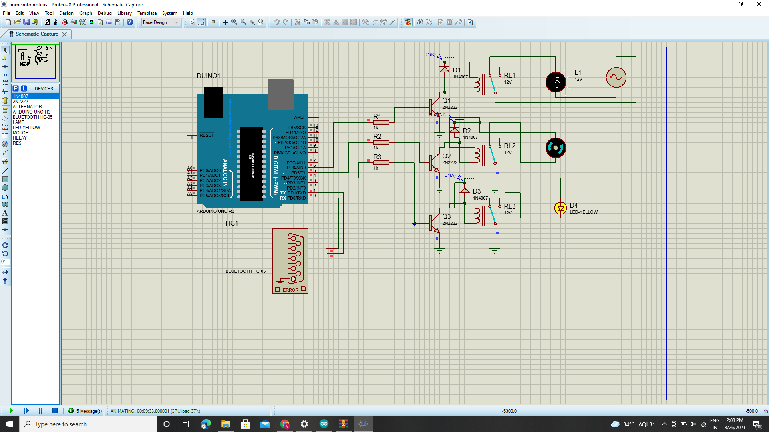
CIRCUIT DIAGRAM:

Slide 5
WORKING:
In this project we are controlling the home appliances with the help of Bluetooth and Internet devices like Google Assistant, Alexa etc.
BT Display is the android app used to send the commands required to control the devices.
In here were are controlling 3 devices Lamp, Fan and Light. We will pair up both phone and PC in which we connected the circuit with the help of bluetooth.
Once we connected the Bluetooth we will send the commands to the devices using the android app and control the devices according to the commands which were given.

Slide 6
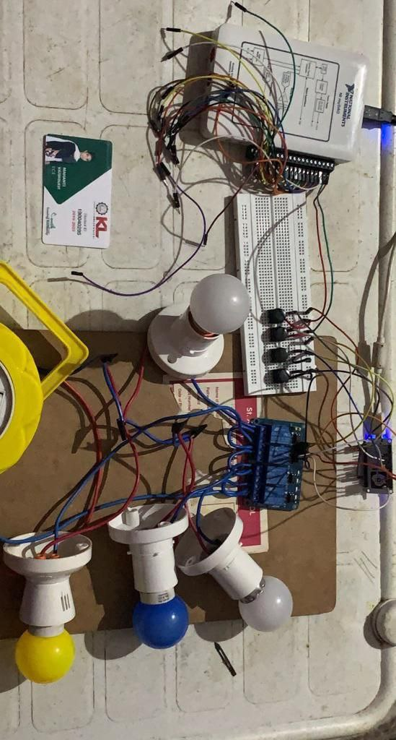
OUTPUT:

Slide 7
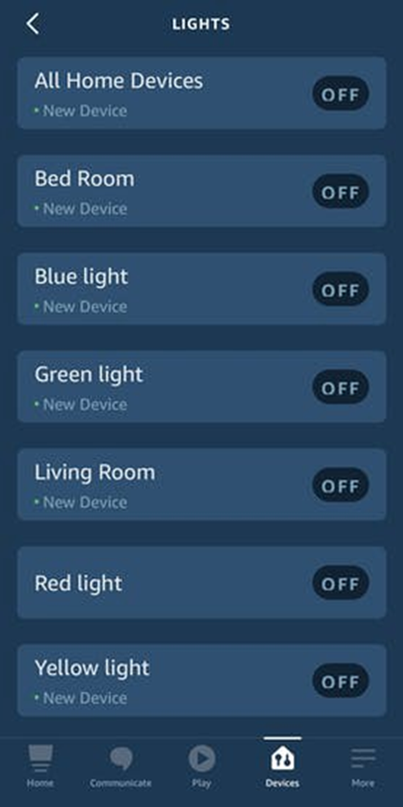
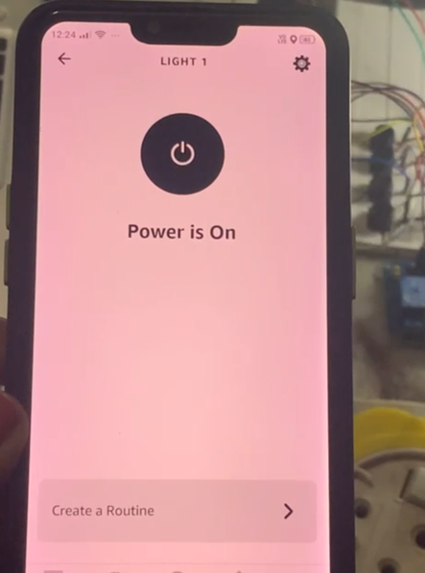

Slide 8
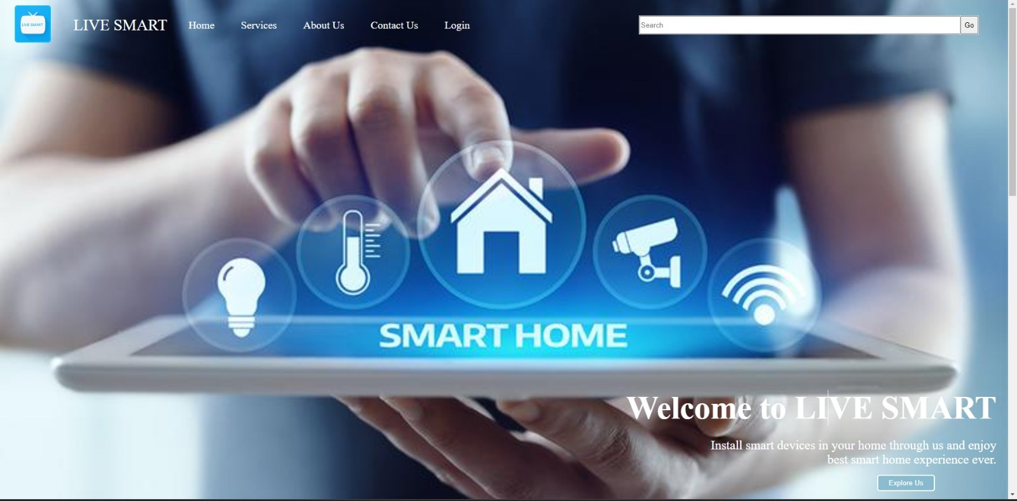
PROPOSAL:WEBSITE:LIVE SMART

Slide 9

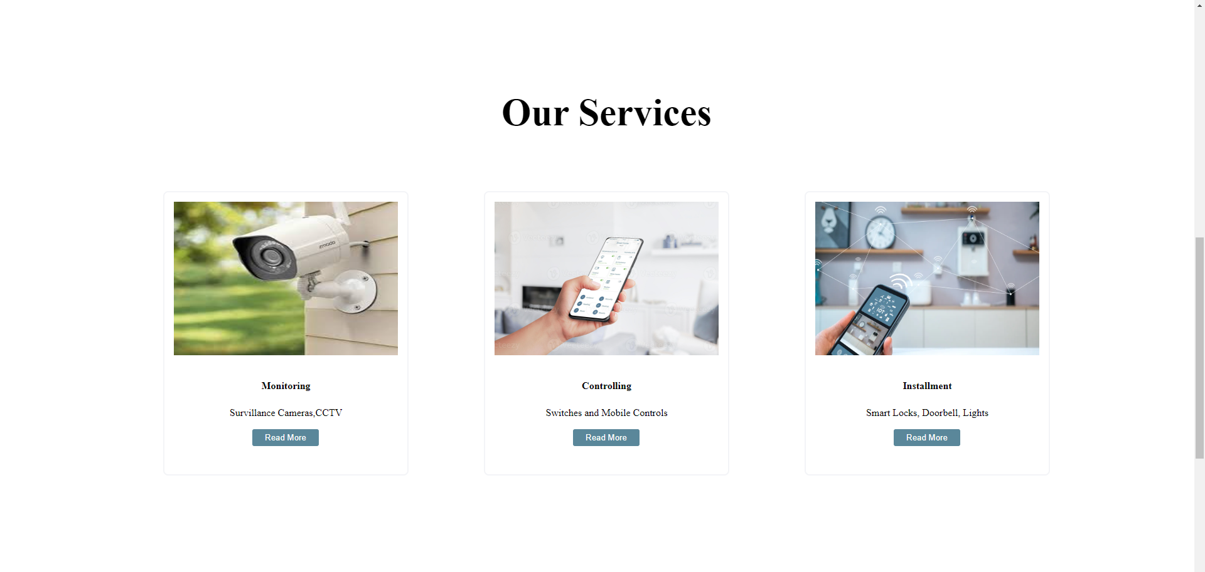

Slide 10
SERVICES PROVIDING IN WEBSITE
NUMBER OF HOURS THE DEVICES WORKED HISTORY
AMOUNT OF ENERGY CONSUMED
TOTAL BILL AMOUNT THAT WILL BE CHARGED IN THE END OF THE MONTH BY USING MACHINE LEARNING
NUMBER OF DEVICES CONNECTED
REPAIR SERVICES WILL PROVIDED IN CASE OF ANY DAMAGE IN THE PRODUCT
HELP ABOUT HOW TO USE THE DEVICE AND WEBSITE
PRECAUTIONS

Slide 11



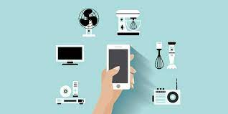
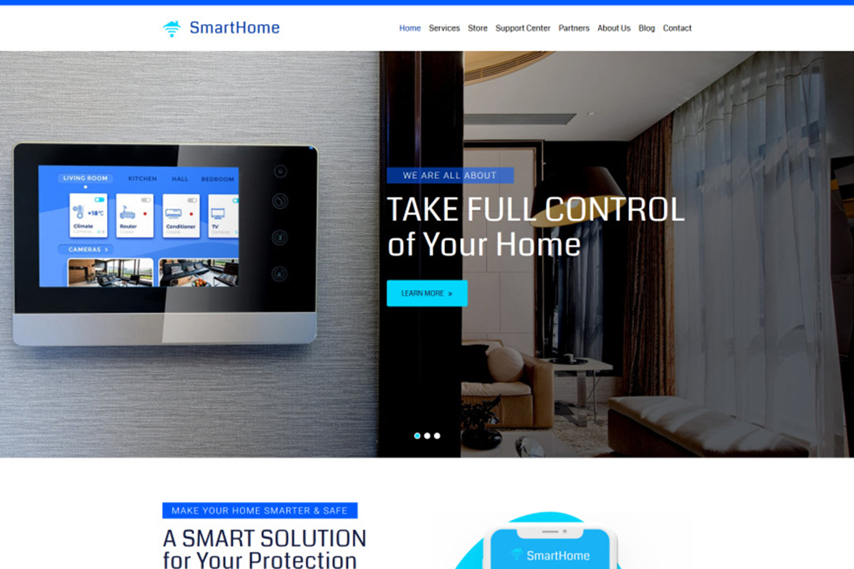
Working Process:
AWS IOT CORE
SMART DEVICES
WEB DEVELOPMENT

Slide 12
CONCLUSION:
In this project by using the android app Alexa is used to control the home appliances from the distance automatically without the manual interference. Incase if we want to control the devices both manually and automatically we can do that in this project too.

